Slide 1

Application Design
Nicklas Andersen

Slide 2
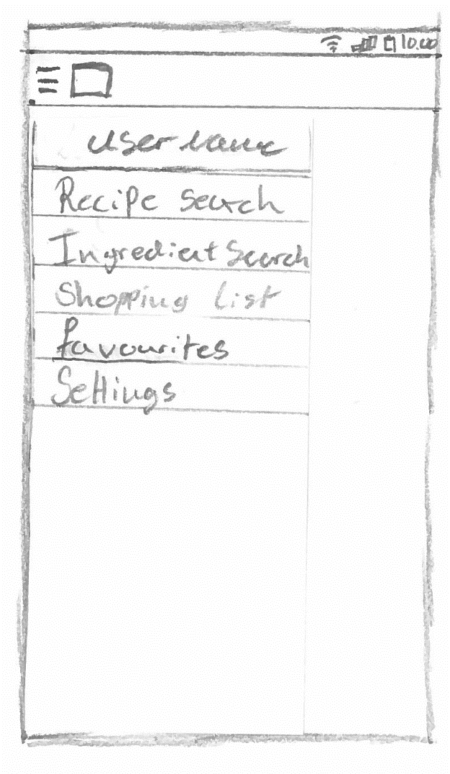
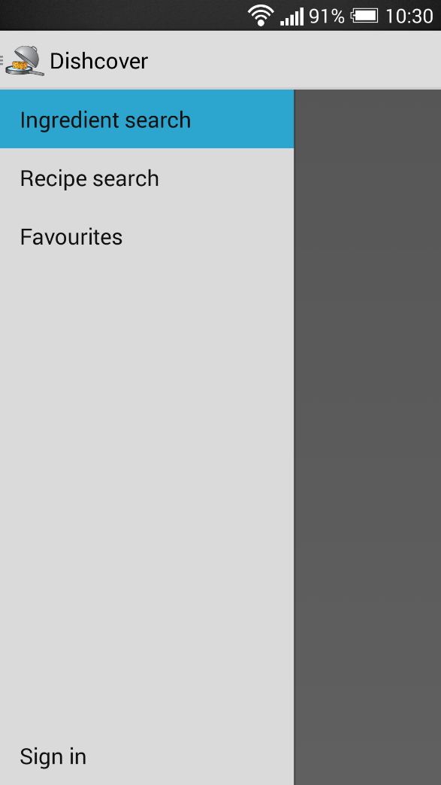
Motivation
concept
App design
Floor plan
Website
Server communication
conclusion
demonstration
Navigation drawer
9 OF 32 | 15.02.2014
Department of computer science
AALBORG UNIVERSITy

Slide 3
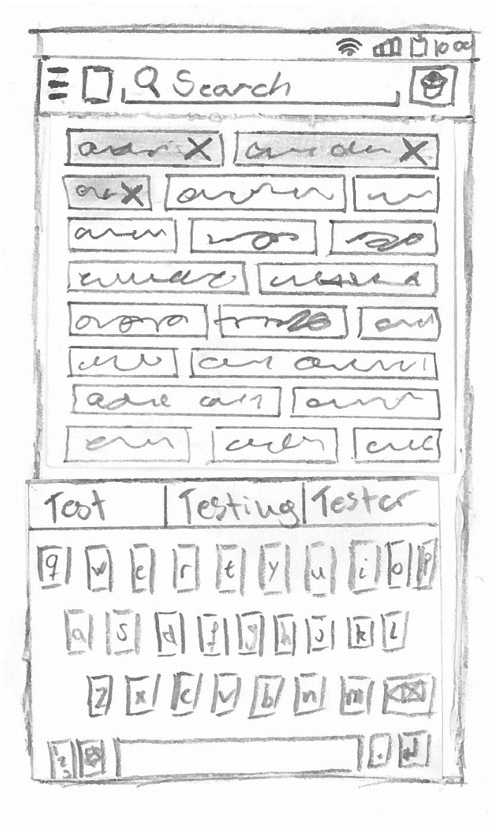
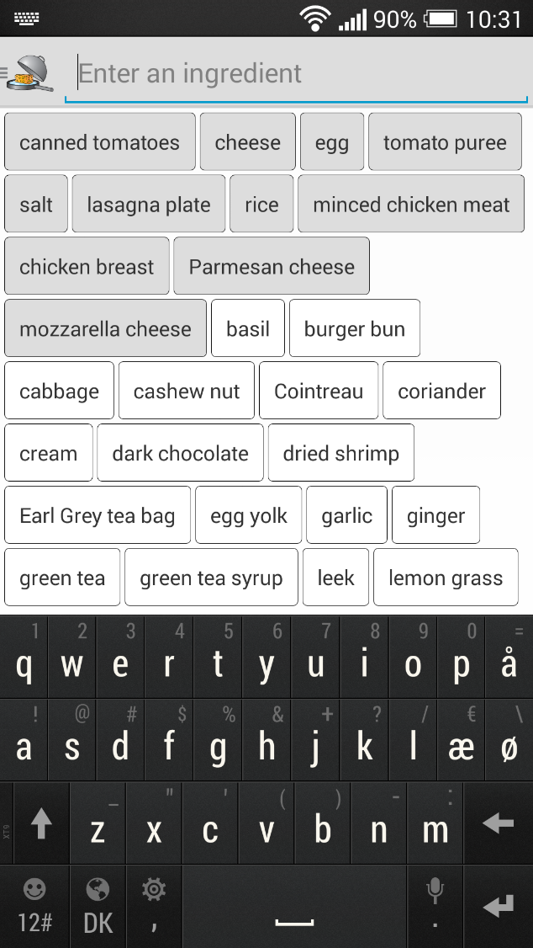
Motivation
concept
App design
Floor plan
Website
Server communication
conclusion
demonstration
Ingredient search
10 OF 32 | 15.02.2014
Department of computer science
AALBORG UNIVERSITy

Slide 4
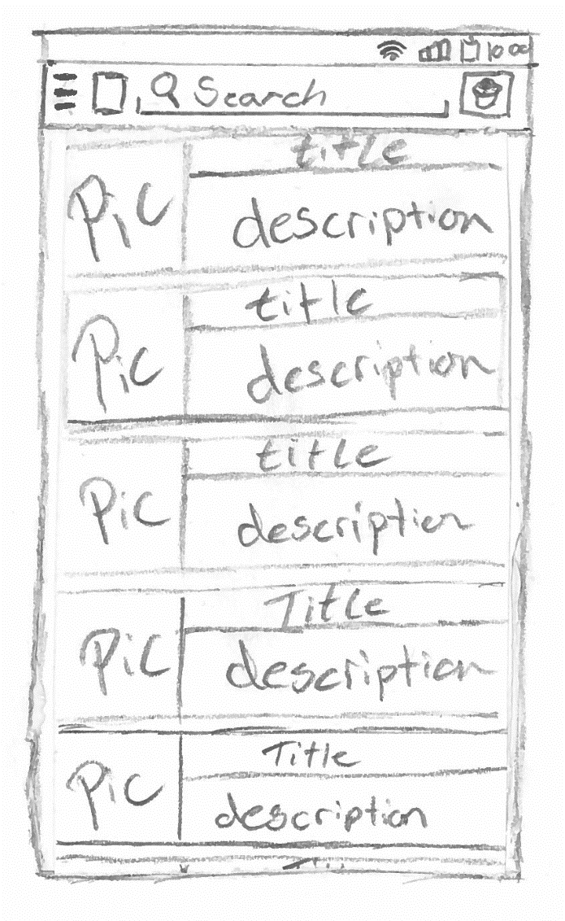
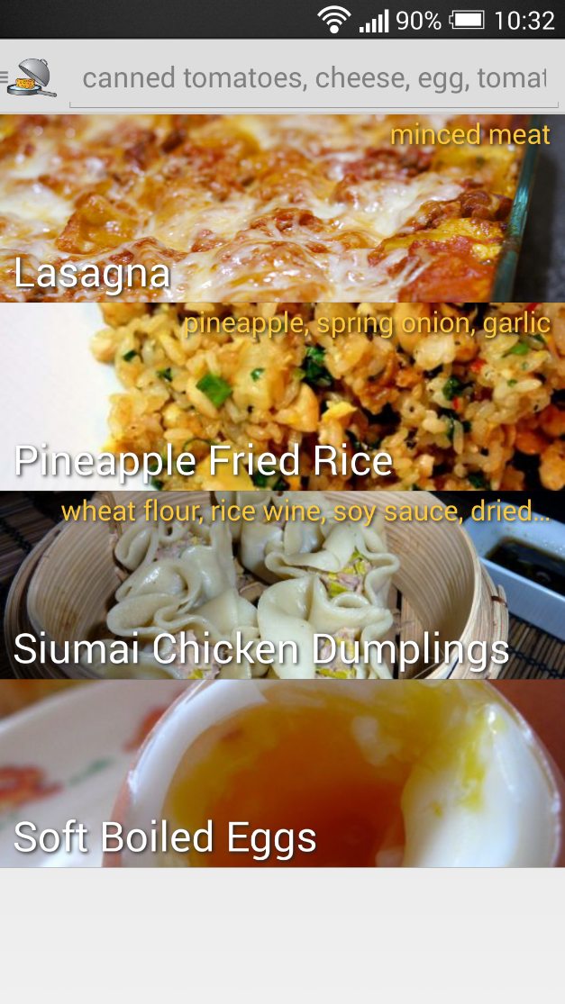
Motivation
concept
App design
Floor plan
Website
Server communication
conclusion
demonstration
Result list
11 OF 32 | 15.02.2014
Department of computer science
AALBORG UNIVERSITy

Slide 5
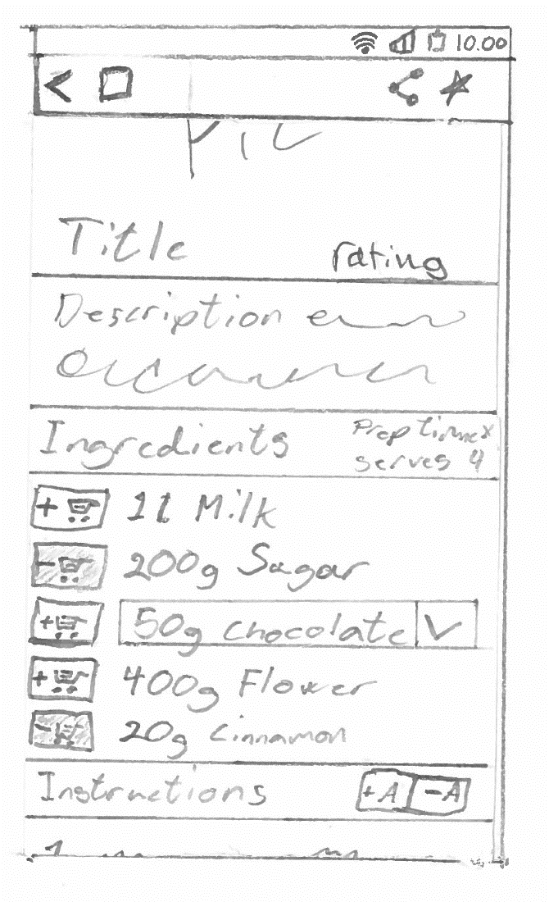
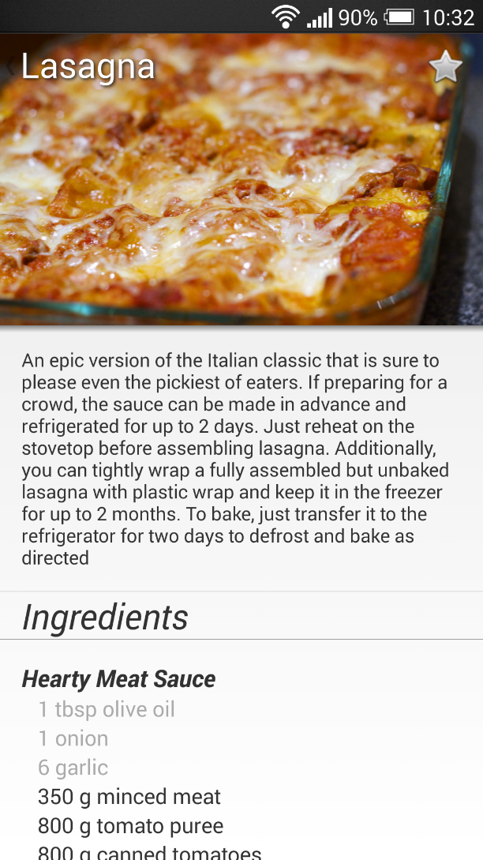
Motivation
concept
App design
Floor plan
Website
Server communication
conclusion
demonstration
Recipe
12 OF 32 | 15.02.2014
Department of computer science
AALBORG UNIVERSITy

Slide 6

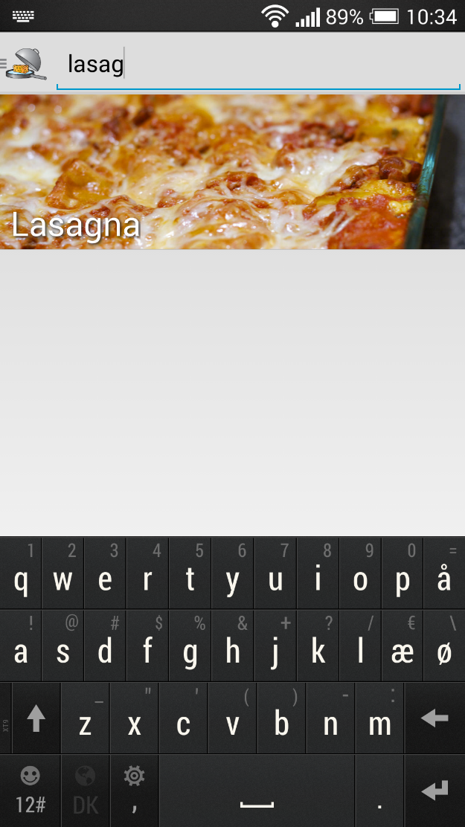
Motivation
concept
App design
Floor plan
Website
Server communication
conclusion
demonstration
Test search
13 OF 32 | 15.02.2014
Department of computer science
AALBORG UNIVERSITy

Slide 7
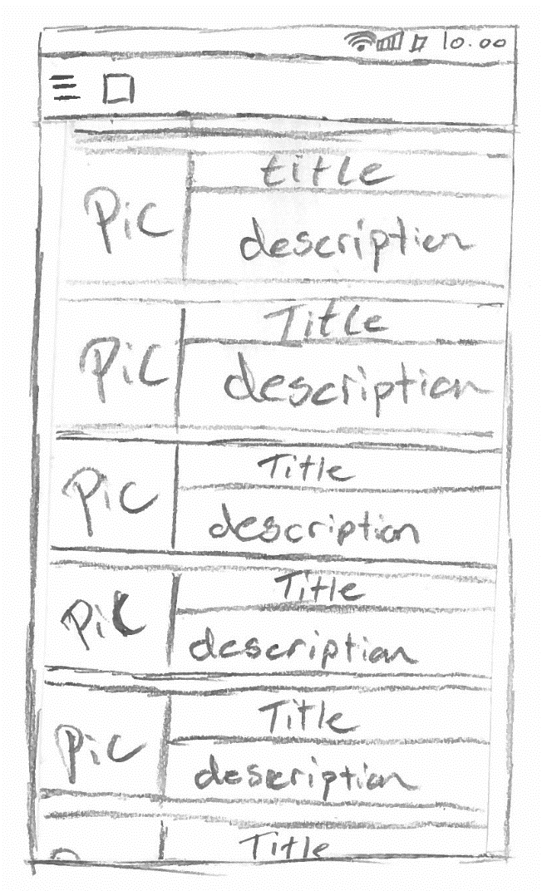

Motivation
concept
App design
Floor plan
Website
Server communication
conclusion
demonstration
Favourites
14 OF 32 | 15.02.2014
Department of computer science
AALBORG UNIVERSITy

Slide 8
Conclusion
Jacob K. Wortmann

Slide 9
Motivation
concept
App design
Floor plan
Website
Server communication
conclusion
demonstration
Conclusion
The application provides relevant recipes based on ingredients
Easy to navigate
Powered by a search algorithm
Support for free-text search
User can login using Google+
Confident that the server returns correct results
31 OF 32 | 15.02.2014
Department of computer science
AALBORG UNIVERSITy

